Slide 1
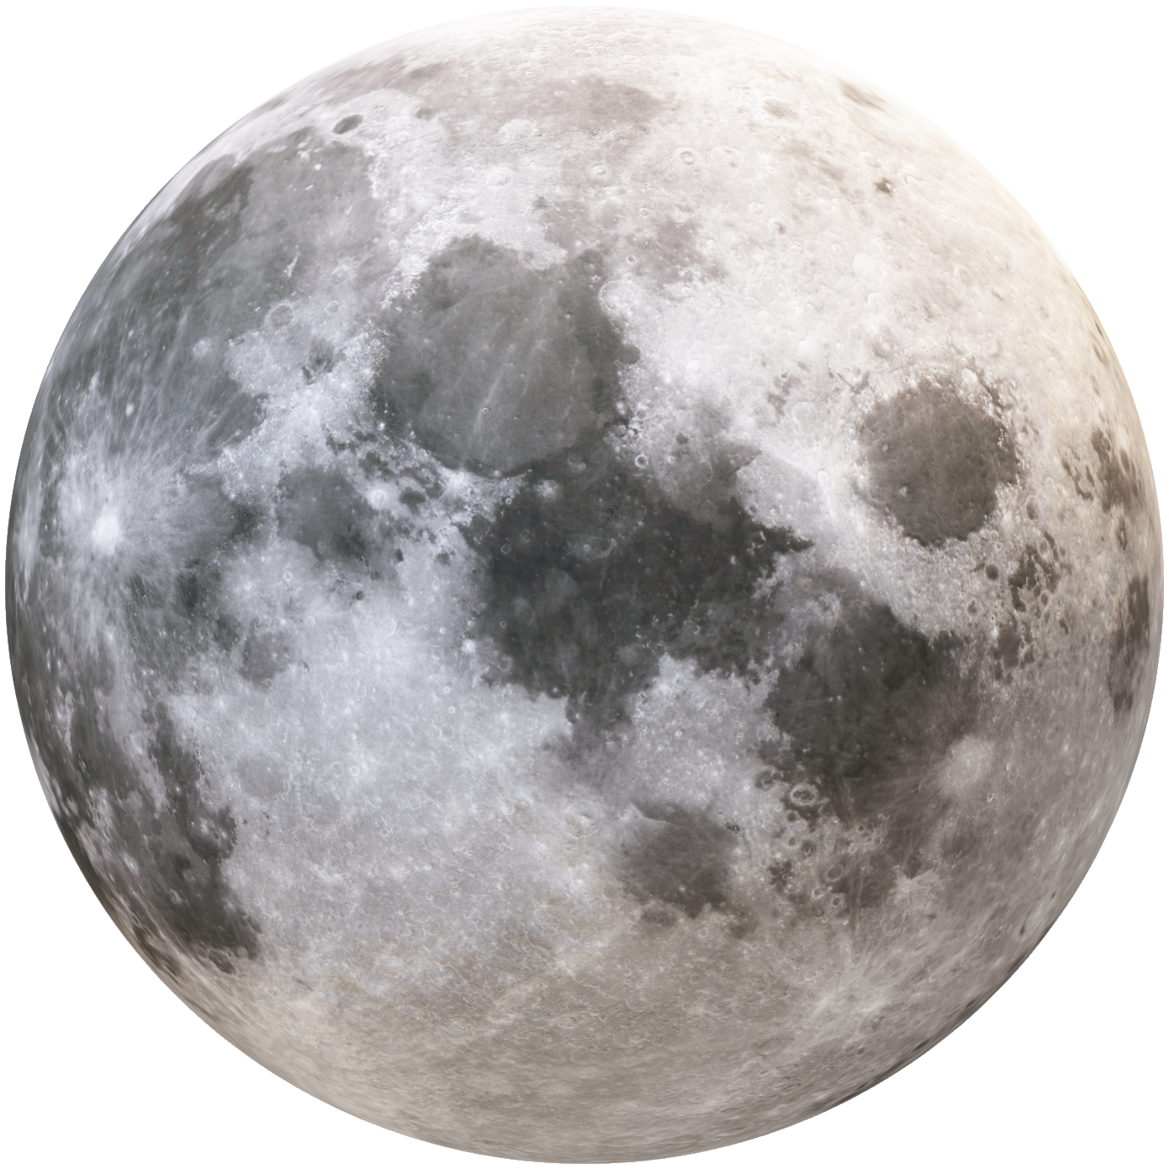


Duration: 105 min
Middle School
Grades: 6 - 8
CCSS, NGSS
Behavior of space
objects
Physics, Physical Science
Click to open in Lifeliqe

Slide 2

Lesson overview
In this activity students will take a trip through the solar system. Fully grasping the concept of the size of the solar system is an abstract and challenging task for any student. Students can investigate the differences between planets’ sizes, speeds, and orbits, as well as the relationship between Earth, the Sun, and the Moon that causes well-known phenomena - eclipses and lunar phases. With a hands-on approach, students will understand these relations and practice while playing.
Learning objectives
Keywords
Understand our position in the solar system and get an idea about patterns in space. Explain what a day and a year are, and how they are connected to the rotation and orbits of planets.
Name all the planets in our solar system.
Investigate how the Earth, Moon, and Sun's relationship causes lunar and solar eclipses Differentiate and name lunar phases and describe their cause.
Earth, Moon, Sun, Solar system, solar eclipse, lunar eclipse, lunar phases, waning gibbous, waxing gibbous, full moon.
Standards
Common Core
CCSS Ela-Literacy WHST.6-8.1.A
Introduce claim(s) about a topic or issue, acknowledge and distinguish the claim(s) from alternate or opposing claims, and organize the reasons and evidence logically.
CCSS Ela-Literacy WHST.6-8.1.C
Use words, phrases, and clauses to create cohesion and clarify the relationships among claim(s), counterclaims, reasons, and evidence.
CCSS Ela-Literacy WHST.6-8.6
Use technology, including the Internet, to produce and publish writing and present the relationships between information and ideas clearly and efficiently.
NGSS
MS-ESS1-1.
Develop and use a model of the Earth-sun-moon system to describe the cyclic patterns of lunar phases, eclipses of the sun and moon, and seasons.
MS-ESS1-3.
Analyze and interpret data to determine scale properties of objects in the solar system.

Slide 3
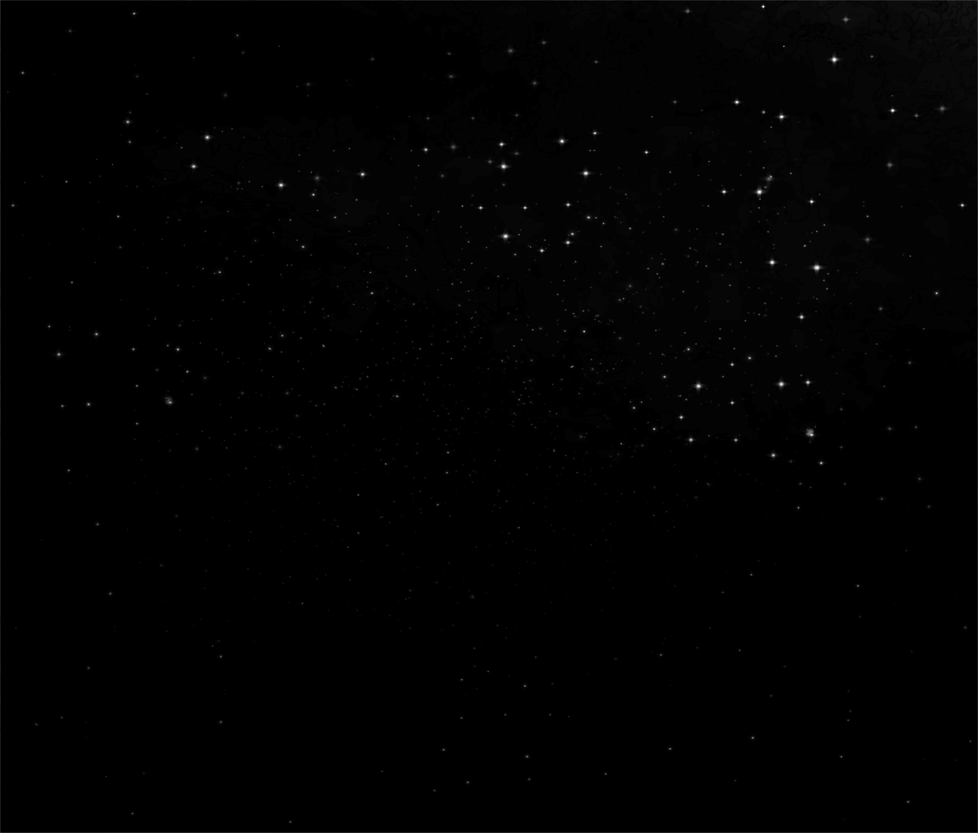
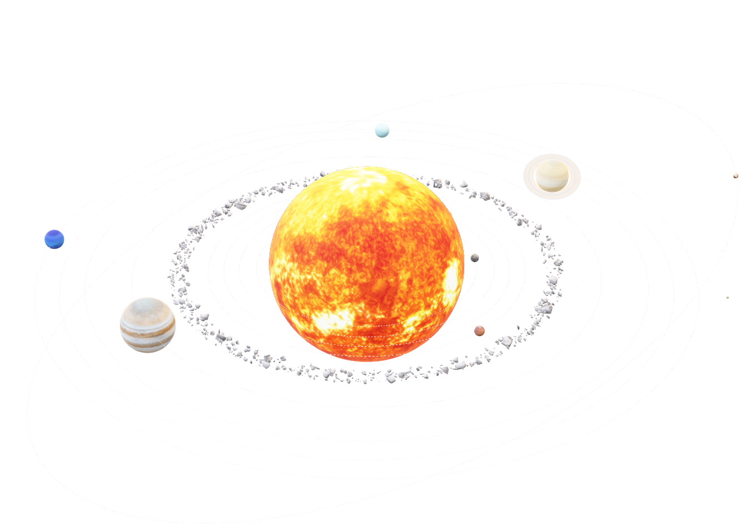
1. The solar system and planets’ orbits
15
min
The solar system is the planetary system Earth belongs to. The most significant, biggest, and heaviest body in the solar system is its central star - the Sun. It contains 99.9% of the total mass of the solar system, and thanks to its gravity it holds together the rest of the bodies that rotate around it. These bodies include eight planets, some dwarf planets, asteroids, comets, and minor interplanetary masses. The eight planets can be divided evenly into two groups - four rocky planets (Mercury, Venus, Earth, Mars) and four so-called gas giants (Jupiter, Saturn, Uranus and Neptune).
While studying the solar system Johannes Kepler discovered the relationship between the time it takes a planet to make one complete orbit around the Sun, its "orbital period", and the distance of that planet from the Sun. If the orbital period of a planet is known, then it is possible to determine the planet’s distance from the Sun. This is how astronomers working without modern telescopes were able to determine the distances to other planets within the solar system.
In general, the farther away from the Sun, the greater the distance from one planet’s orbit to the next. The orbits of the planets are not circular but slightly elliptical, with the Sun located at one of the foci of the ellipse.
Open the Solar system scene, click on Slower revolution, and zoom closer to the first couple of planets, including the Earth, to explain the system and how the planets spin. Then highlight the Earth and show the size comparison with the Sun, pointing out how it shines and how far away it is. Then you can zoom out to the rest of the system and talk about orbits and their shape, and about the sizes of the planets.
Note: The sizes of bodies and orbits in the visualized model of the solar system don't correspond with reality. Only the sizes of planets OR orbits are in correct proportion - but each is in a different scale from the other.
Click on the model to interact

Slide 4
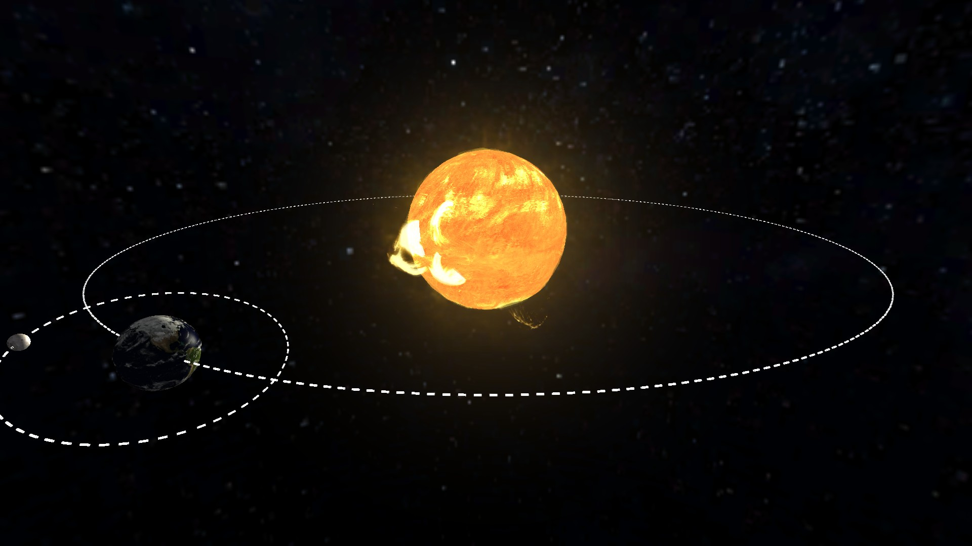
2. Relation between Earth, Sun, and Moon
15
min
As the Moon revolves around the Earth, both Earth and the Moon revolve around the Sun. The path that Earth takes around the Sun is Earth’s orbit. And similarly the path that the Moon takes around Earth is the Moon’s orbit. A pulling force called gravity keeps the Moon and Earth in their orbits.
The Moon is the closest cosmic neighbor of our planet, orbiting around it at an average distance of 380,000 km (236,000 mi). Compared to Earth, however, it is almost four times smaller in diameter. Thanks to so-called bound rotation, the same hemisphere of the Moon constantly faces toward Earth.
The Moon is thought to have formed approximately 4.5 billion years ago, not long after Earth. There are several hypotheses for its origin; the most widely accepted explanation is that the Moon formed from debris left over after a giant impact between Earth and a Mars-sized body called Theia.
Click to open in Lifeliqe
Open the Solar and Lunar Eclipse scene to observe the orbits of the Moon and Earth and the relation to changing seasons.

Slide 5
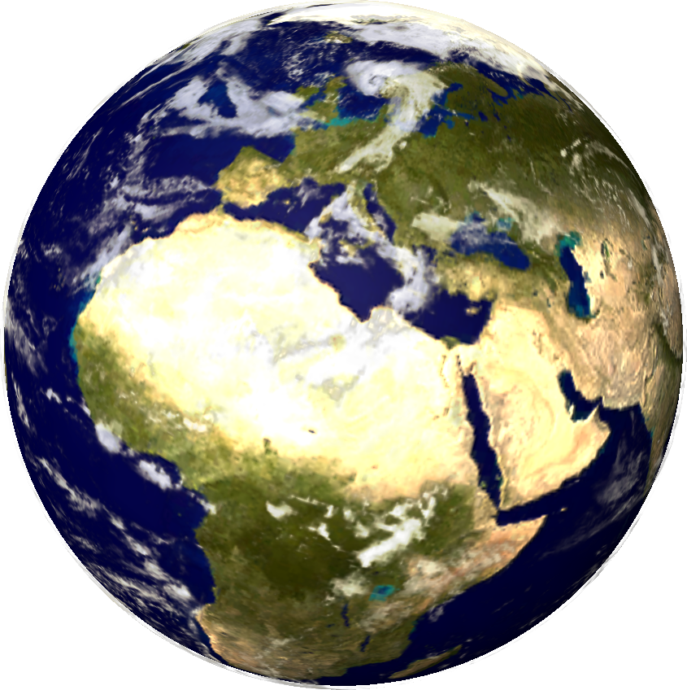
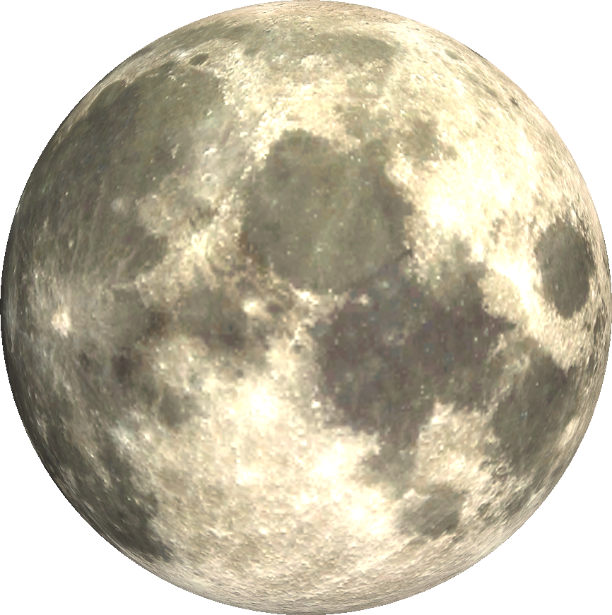
Open the Earth and Moon scenes to study the objects further.
Click to open in Lifeliqe
Click to open in Lifeliqe
Earth is tilted as it revolves around the Sun. That is because Earth has a tilted axis. Earth’s axis is an imaginary line that runs from pole to pole through the center of Earth. As Earth revolves around the Sun, its tilt causes the seasons. The part of Earth that is tilted toward the Sun experiences summer because it gets more direct sunlight. The part of Earth tilted away from the Sun experiences winter because it gets less direct sunlight. During spring and fall, Earth’s axis is not tilted toward or away from the Sun. All four seasons occur during one orbit. One complete orbit is one year.
Earth also rotates on its axis, which causes the alternation of day and night. Sunlight brightens the side of Earth facing the Sun causing a day. It is night on the side of Earth facing away from the Sun. One complete rotation around the axis takes one day = 24 hours.

Slide 6
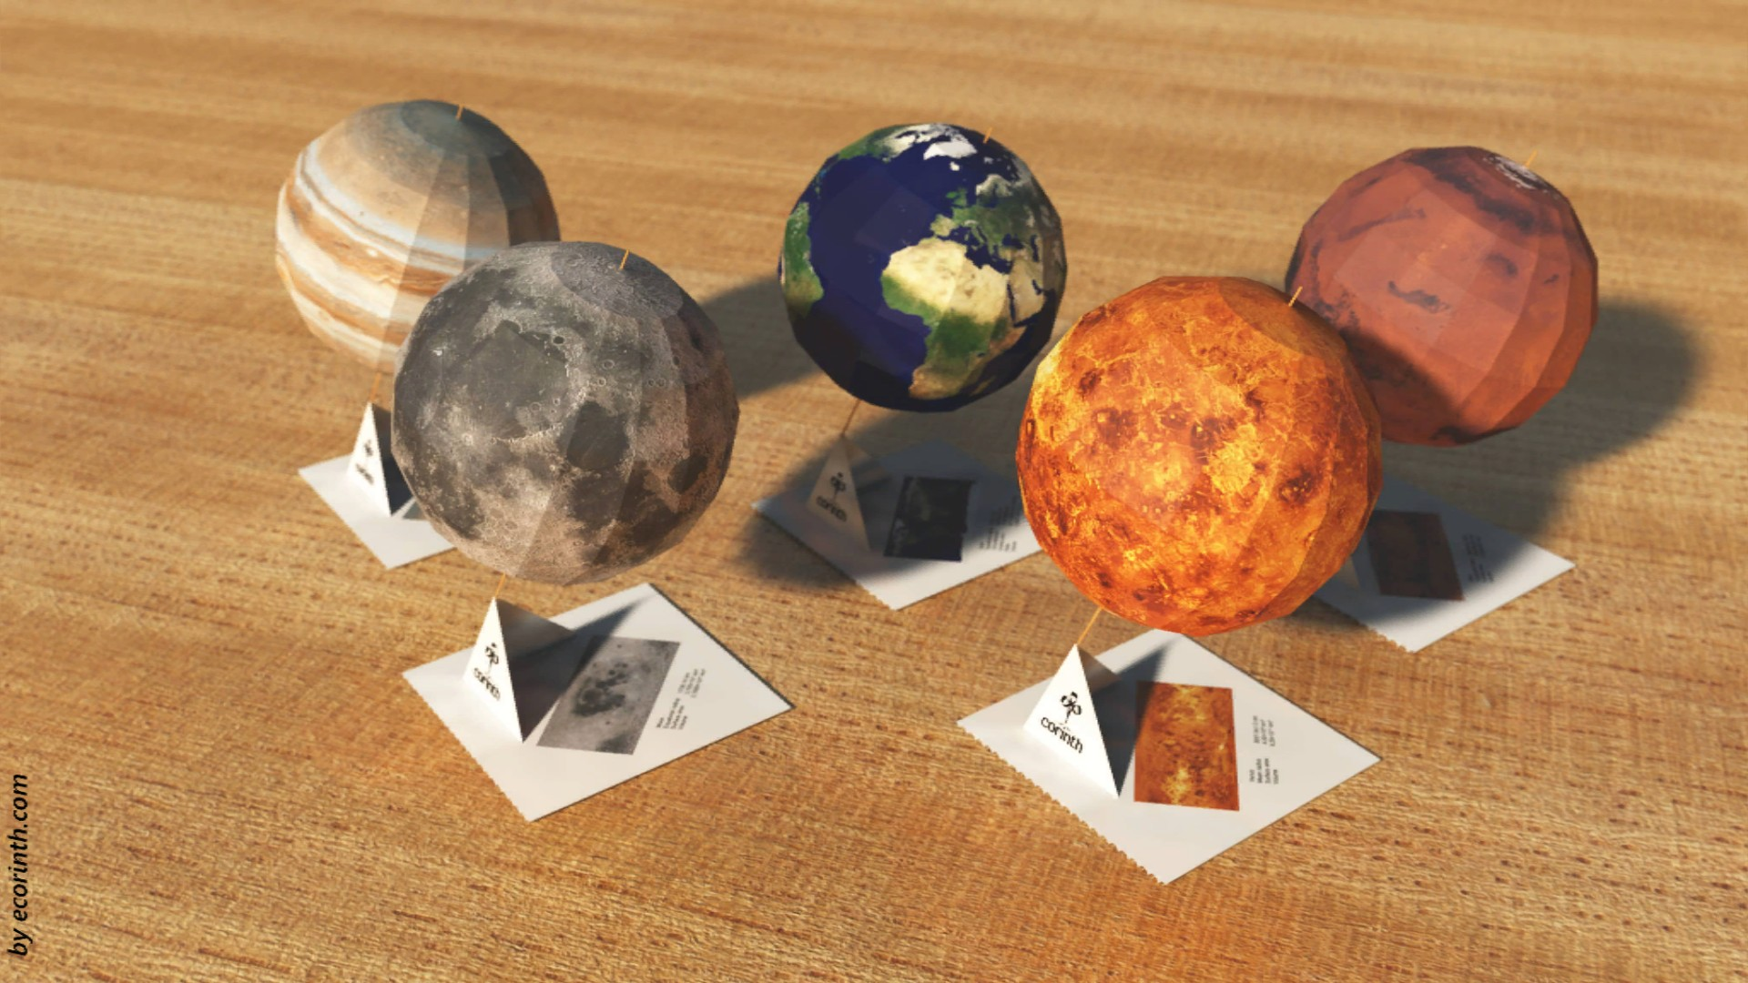
3. Your own solar system - papercut models
30
min
Find the scene Sphere - Papercut Planets in the Lifeliqe app, and print out the models print some of the larger planets like Jupiter or Saturn on A3/11”x17” sheets, and the Moon and Mercury on A5/one-half 8.5”X11” sheets to show the differences in size.
Distribute the print-outs among the students, and help them with cutting and gluing they can work in groups or individually. Once ready, attach models to toothpicks or sticks, and use a lamp to represent the Sun (it should be significantly bigger than the planets).
Clear an adequate space in the classroom, and choose 10 students to represent the planets, the Moon, and the Sun - each of the students should then take the model and get into the proper position, then run/slowly walk in circles around the student representing the Sun (who is holding the lamp).
Explain the differences in speed of revolution and distance in orbits, and their connection to the measurement of time, for instance:
Mercury has an orbital period of 88 days, meaning a single year there lasts 88 Earth days. But because of Mercury’s slow rotation (only once every 59 days) and its rapid orbital speed, one day on Mercury actually works out to approximately 176 Earth days.
Mars takes the equivalent of 687 Earth days to complete a single orbit around the Sun, which works out to 1.88 Earth years. On the other hand, Mars has a rotation period that is very
similar to Earth’s – 24 hours, 39 minutes, and 35.244 seconds.
Jupiter takes only 9 hours 55 minutes and 30 seconds to rotate once on its axis, but it also takes 11.8618 Earth years to complete an orbit around the Sun. This means that a year on Jupiter is the equivalent of 4,332 Earth days.
A year on Neptune is the longest of any planet, lasting the equivalent of 164.8 years (or 60,182 Earth days). But since Neptune also takes comparatively little time to rotate once on its axis (16 hours, 6 minutes and 36 seconds), a single year lasts a staggering 89,666 Neptunian days.

Slide 7
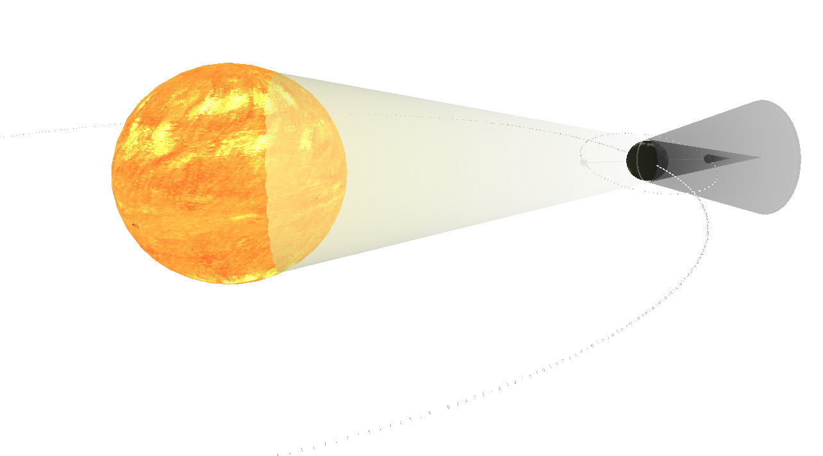
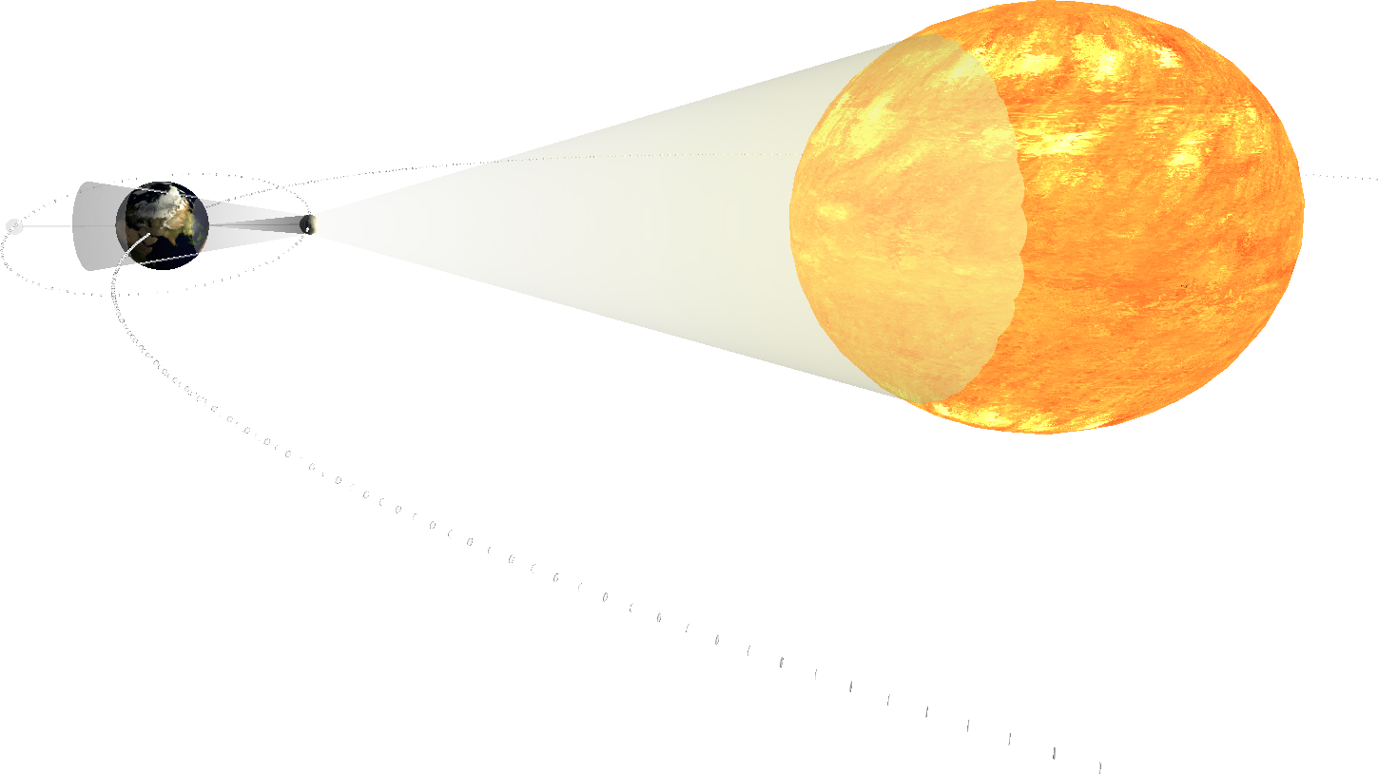
5. Activity – Every cell is unique
15
min
Continue playing with the models - take the Sun (the big lamp), Earth, and Moon, and show students the orbits of Earth and the Moon that lead to lunar and solar eclipses - You can also use the Lifeliqe app - open the scene Solar and Lunar Eclipse to illustrate your lecture:
An eclipse is an astronomical event. It occurs when an astronomical object (Sun, Moon) is temporarily obscured, either by passing into the shadow of another body or by having another body pass between it and the viewer. From the Earth we can observe an eclipse involving the Sun, Earth, and Moon. It can occur only when all three objects are in a nearly straight line, allowing one to be hidden behind another, as viewed from the third. The orbital plane of the Moon is tilted with respect to the orbital plane of Earth. Therefore eclipses can occur only when the Moon is close to the intersection of these two planes. We call them the nodes. The Sun, Earth, and nodes are aligned twice a year. A lunar eclipse occurs when Earth passes between the Moon and the Sun, and Earth's shadow obscures the moon or a portion of it. A solar eclipse occurs when the Moon passes between Earth and the Sun, blocking all or a portion of the Sun. An eclipse can be total, partial, or annular.
Click to open in Lifeliqe
Click to open in Lifeliqe

Slide 8
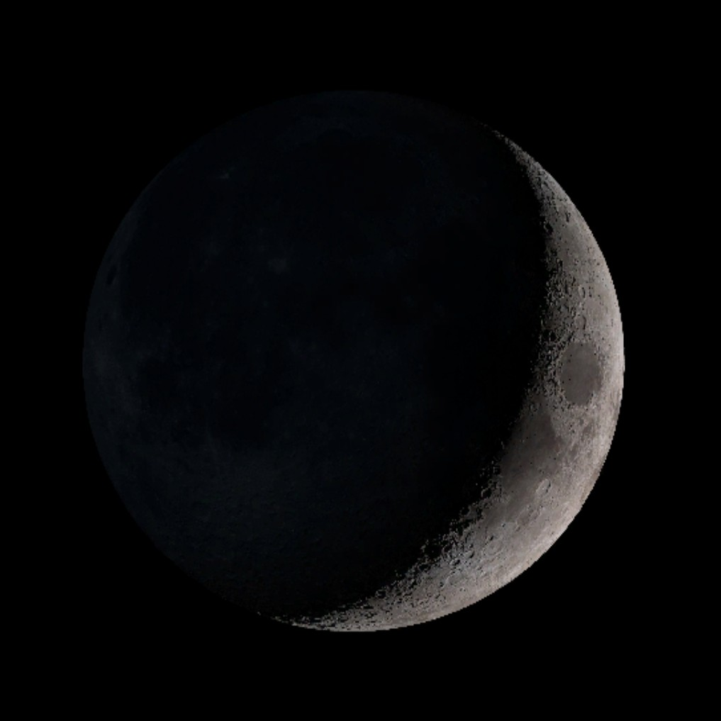
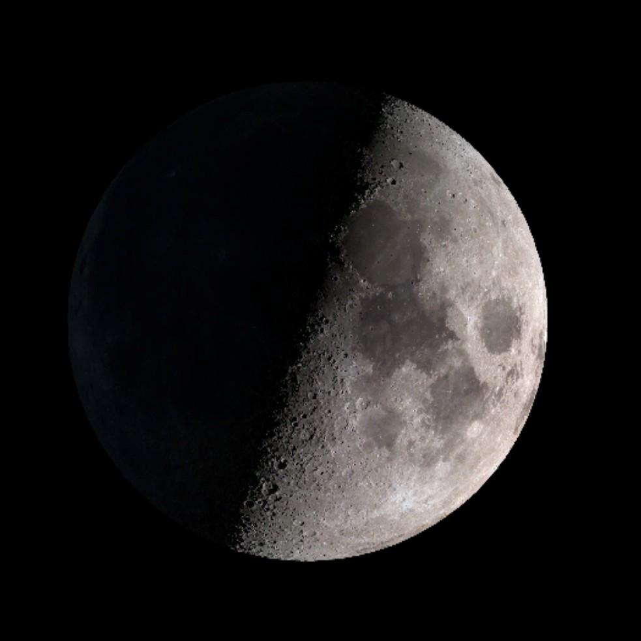
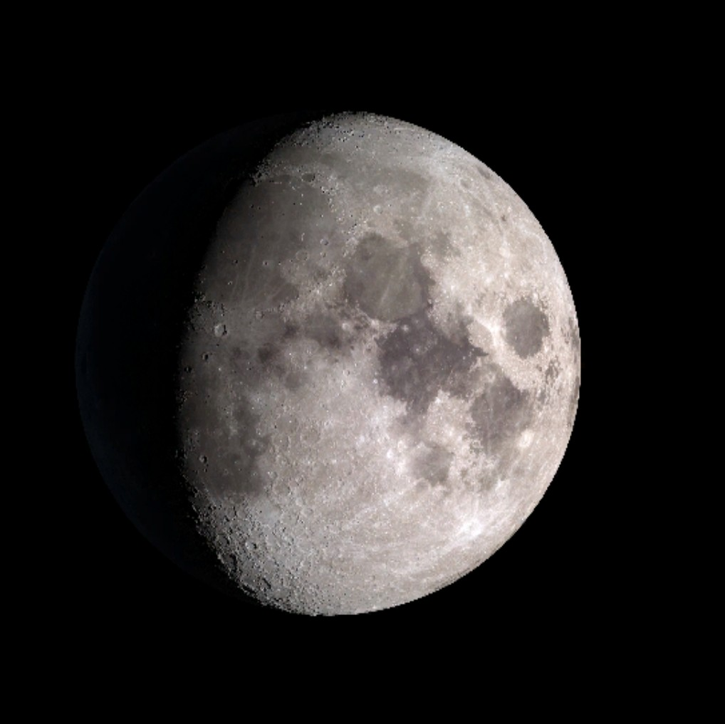
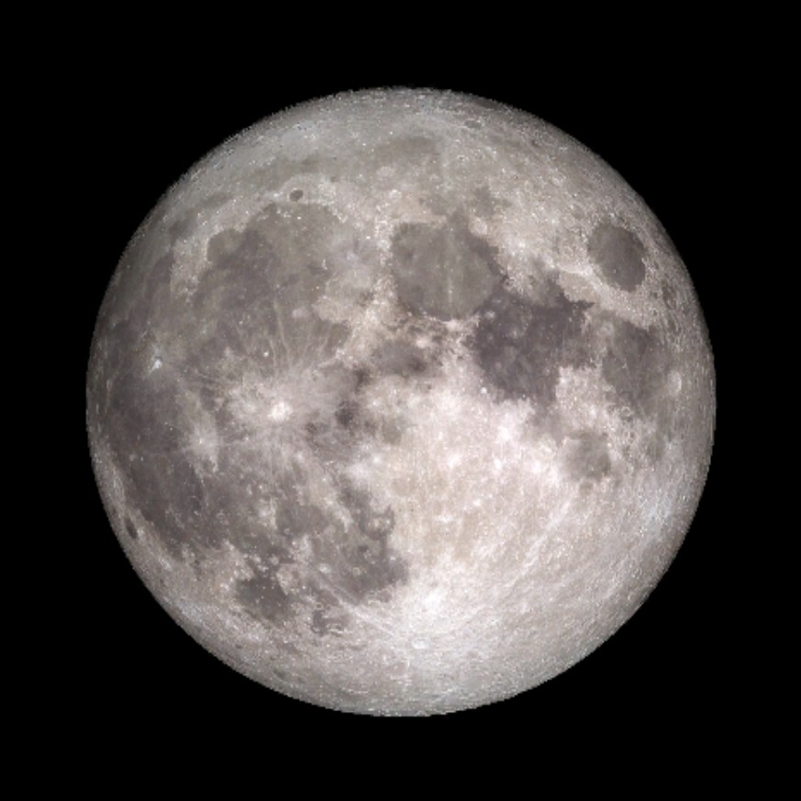
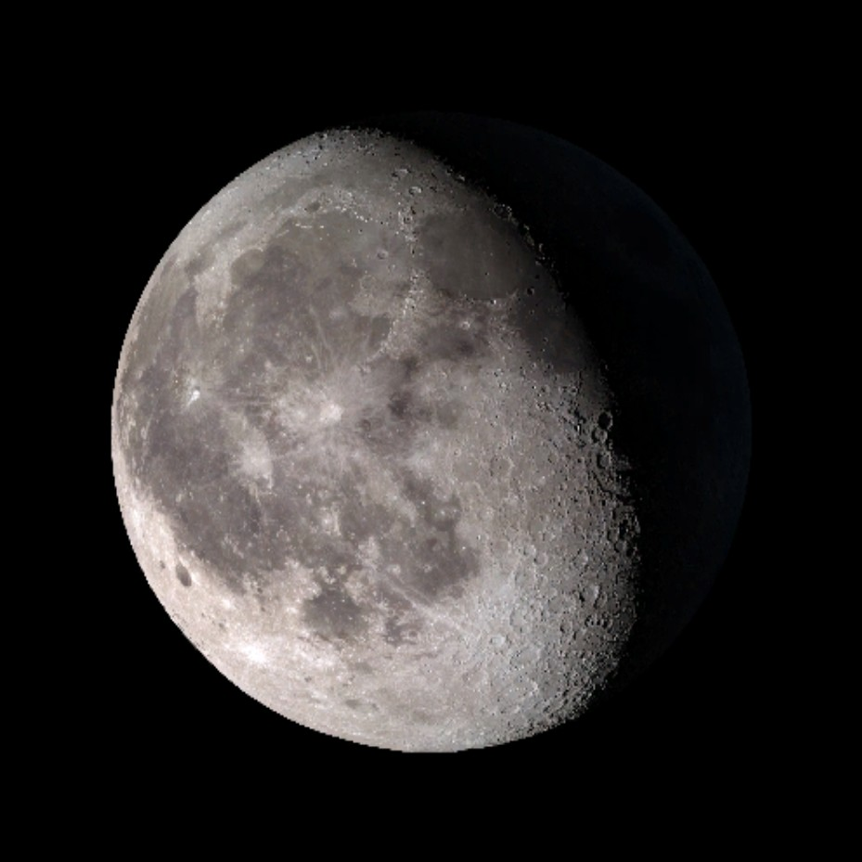
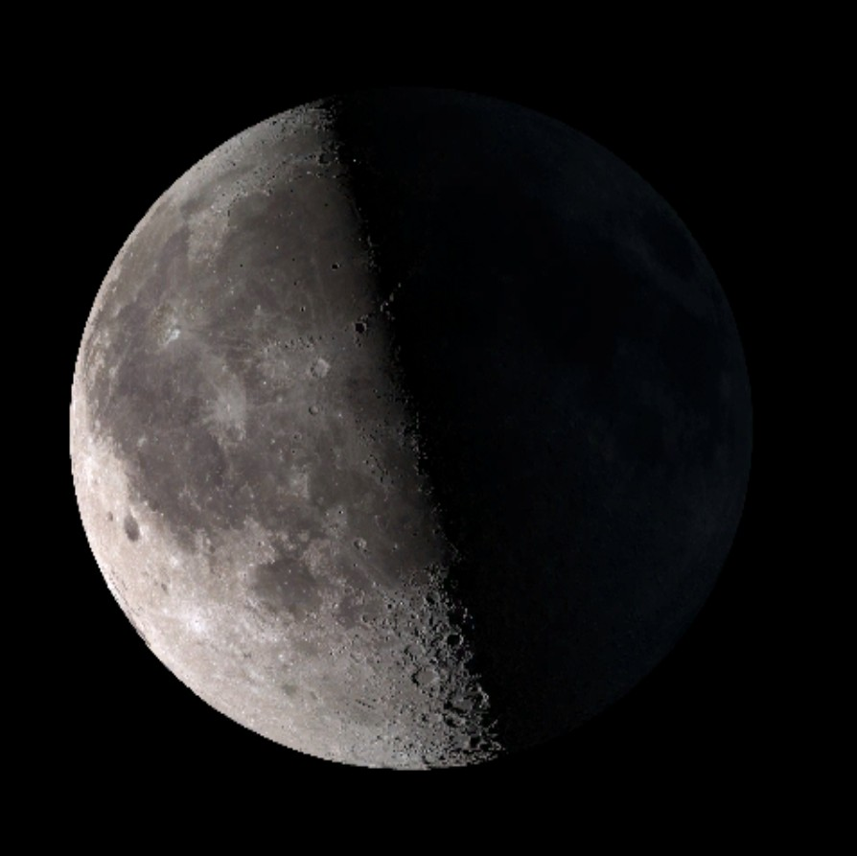
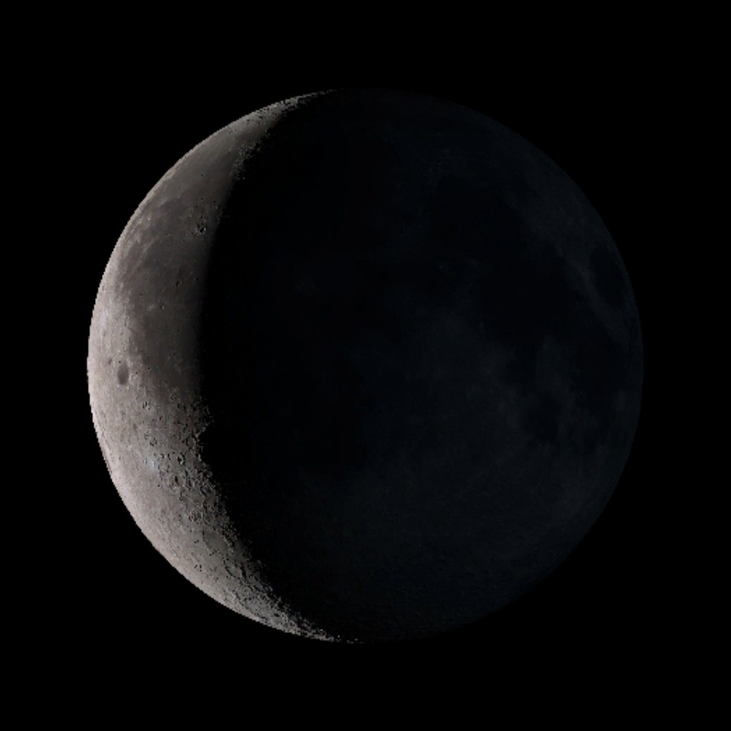
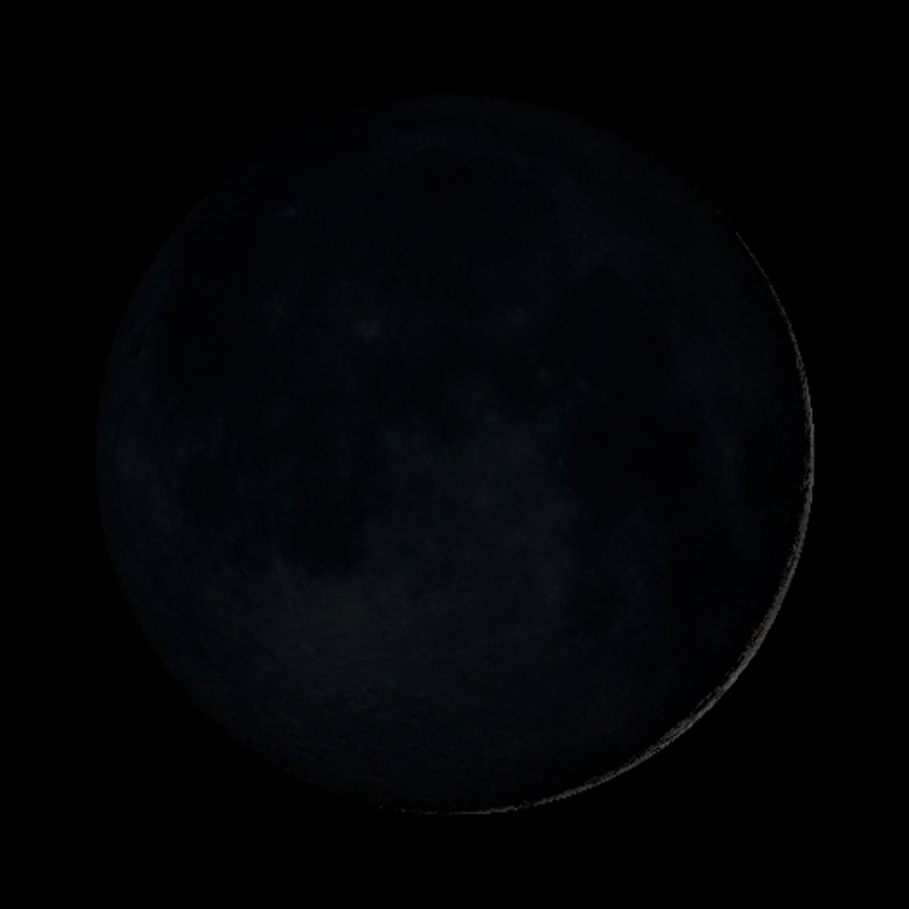
6. Final Exercise - Lunar phases
20
min
The Moon is not illuminated by the Sun consistently during its movement around the Earth. The shape of the illuminated portion of the Moon as seen by an observer on Earth is called the lunar phase. The lunar phases change periodically. We always see the same lunar side from the Earth.
We distinguish eight typical lunar phases. In fact, more often we tend to speak only about the four principal lunar phases. They are the New Moon, First Quarter, Full Moon, and Third Quarter. The differences in the appearance of these phases are most evident in the First and Third Quarter phases. In the first one, we observe the right side of the Moon illuminated. The illuminated right portion of the Moon means for the observer in the northern hemisphere that the part is always growing (referred to as Waxing). If the right side of the Moon is dark (Third Quarter), then the light part is shrinking, and the Moon is referred to as Waning. In the southern hemisphere the Moon is observed from a perspective inverted to that of the northern hemisphere.
Open the scene Lunar phases - gallery and project it on the board.
Select three students again to represent the Sun, Moon, and Earth, and equip them with models and the lamp (the Sun).
Click through the lunar phases in the gallery, and instruct the students to recreate the positions of the Sun, Earth, and Moon to obtain the same result as shown in each particular picture. Let the other students give advice and take notes to remember the names of each phase. Let students switch roles in practicing.
Once you have practiced the names and positions of all the phases enough, you can play a game - randomly call out the names of phases and challenge students to recreate them as fast as possible. With a bigger class, you can divide students in groups and let them compete. (You would need more models, and some sort of reward for the winning team would be a nice addition). :)
Waxing Crescent
First Quarter
Waxing Gibbous
Full Moon
Waning Gibbous
Third Quarter
Waning Crescent
New Moon
Click to open gallery in Lifeliqe

Slide 9
7. Final Wrap-up of the key findings and discussion
10
min
Wrap up all the findings and materials explained in the classroom, and set up the discussion to finalize the class.
Questions for the discussion:
Name the planets in our solar system in their correct order. What other objects in the solar system can you name?
What are the four main phases of the moon? How long does it take to change from one to another?
What is an eclipse? Explain the positions of the Moon and Earth during a solar eclipse. Does the Moon rotate? What is a “bound rotation”?
Due to the revolution of the moon and the rotation of Earth, sometimes we can see the Moon during the day. Could there be any position of the Sun, Moon, and Earth that might allow us to see a lunar eclipse during the day? Explain your answer.
Further activities
Visit a planetarium to study physical models and representations.
Let students write an essay about how the Moon affects the Earth’s systems (e.g., tides) and what would happen if there weren’t a Moon at all.
Make a lunar calendar to show the repetition of the cycle and the system of calculating the phases.

Slide 10

Thanks for using Lifeliqe's lesson plan!
Excite your students in learning science with 1,000+ more 3D models and lesson plans at online.lifeliqe.com

